Slide 1
Web Server
Aj.Drusawin Vongpramate
Information Technology
Science, BRU

Slide 2
The Apache HTTP Server Project is an effort to develop and maintain an open-source HTTP server for modern operating systems including UNIX and Windows. The goal of this project is to provide a secure, efficient and extensible server that provides HTTP services in sync with the current HTTP standards.

Slide 3
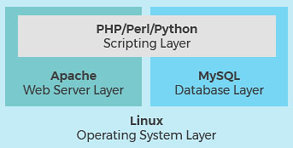
Web Server Visualize

Slide 4
Install Web Service
Step 1: Update your system
$ sudo yum update
Step 2: Install Apache
$ sudo yum install httpd
Step 3: Start Apache service
$ sudo systemctl start httpd.service

Slide 5
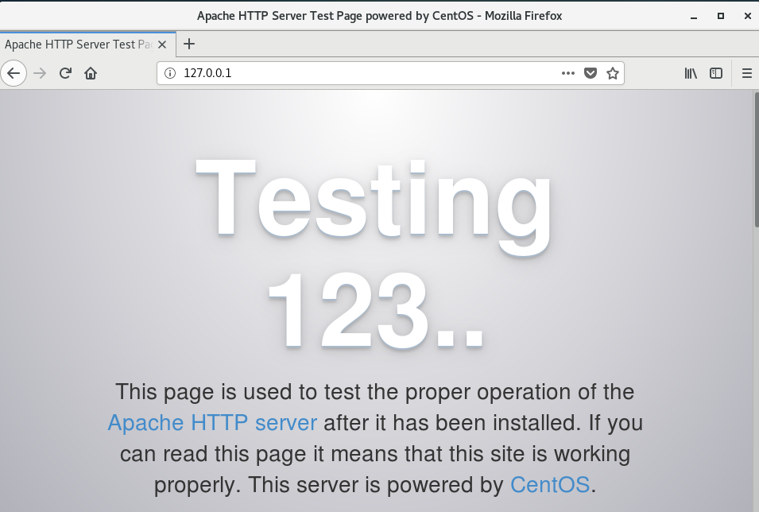
Testing @ http://127.0.0.1

Slide 6
Install Web Service
Step 4: Activate Apache to start during system boot
$ sudo systemctl enable httpd.service
//reboot
$ sudo reboot
//check at browser again

Slide 7
Open the HTTP (80) and HTTPS (443) ports in the firewall
//HTTP
# firewall-cmd --permanent --zone=public --add-service=http
//HTTPS
# firewall-cmd --permanent --zone=public --add-service=https
//Reload firewall
# firewall-cmd --reload

Slide 8

The enterprise open source database for modern, mission-critical applications with transactional, analytical or hybrid transactional/analytical workloads at any scale, MariaDB Platform extends MariaDB Server, the fastest growing open source database, with enterprise-grade high availability, security, scalability and analytics.

Slide 9
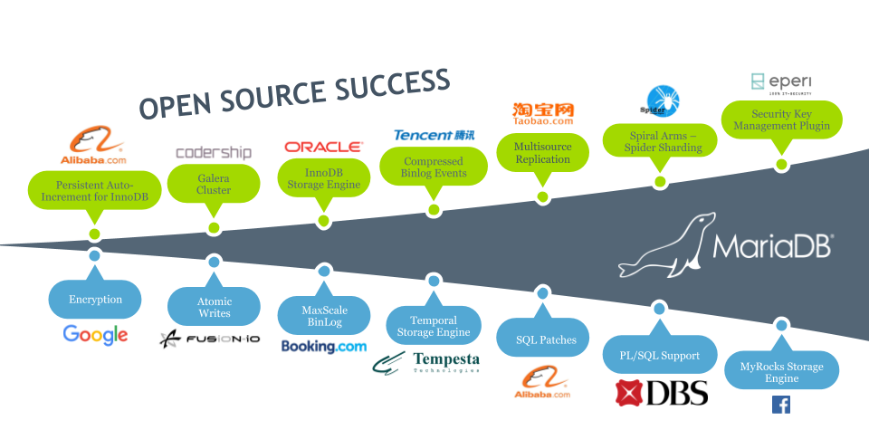
MariaDB Application

Slide 10
Install MariaDB
//MariaDB is a forked version of MySQL
$ sudo yum install mariadb-server mariadb
//start the service
$ sudo systemctl start mariadb
//Securing MariaDB ****
$ sudo mysql_secure_installation

Slide 11
Install MariaDB
//enable MariaDB to start during system boot
$ sudo systemctl enable mariadb.service
//reboot
$ sudo reboot
//check it at Terminal
$ mysql
> show databases

Slide 12
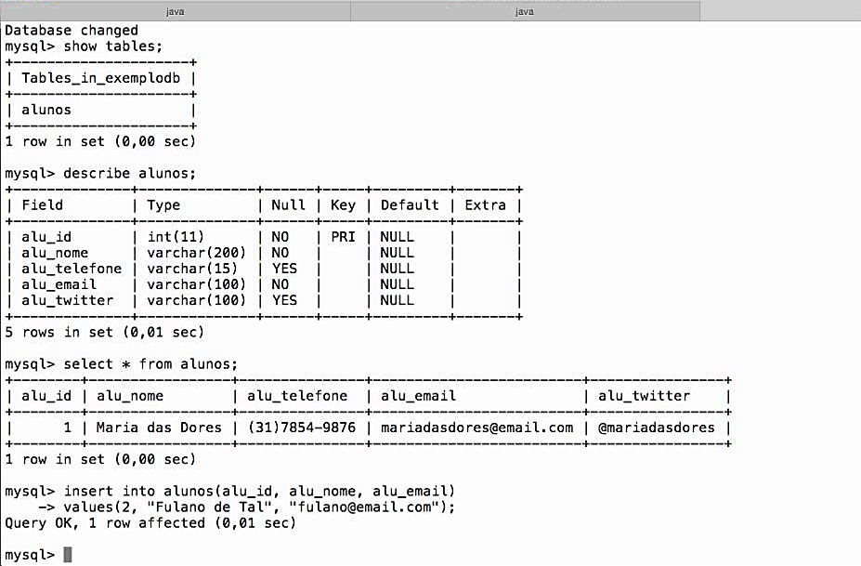
Testing @ Terminal

Slide 13
Install PHP
$ sudo yum install php php-mysql
//restart Apache web server one more time for it to work with PHP
$ sudo systemctl restart httpd

Slide 14
Testing
//install nano editor
$ sudo yum install nano
//create ‘info.php’ file
$ sudo nano /var/www/html/info.php
//type this
<?php
phpinfo();
?>

Slide 15
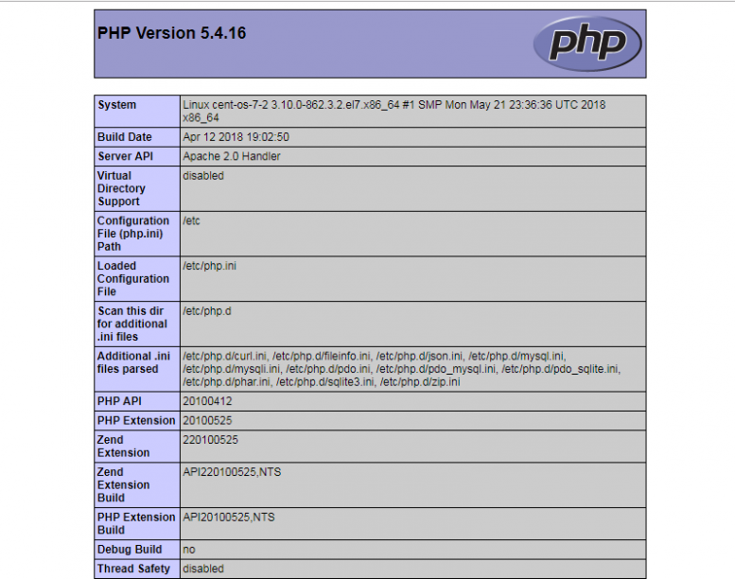
Testing @ http://127.0.0.1/info.php

Slide 16
Q & A

